Slide 1






DevOps: Putting Value for ALL in your Value Stream Mapping
Dan Stolts (@ITProGuru) Chief Technology Strategist US DX North East – Audience Blog: ITProGuru.com
dstolts@Microsoft.com
www.linkedin.com/in/danstolts
Specializations:
Cloud, Virtualization, Windows Server
Open Systems, Hybrid Cloud, Storage
aka.ms/70-534-book
@ITProGuru
Notes:
DevOps How To Put Value For All Into A Value Stream Mapping
The Value Stream Mapping (VSM) is the first and by far the most important part of your DevOps Journey. Learn how to get started with the VSM and how to keep the discussion going. We will also cover the importance of doing a VSM, requirements you should adopt for a VSM including the basics: Who, What, Where, When, Why and How. You will learn how to make your VSM successful from prep to results.
Learn how to get started with the VSM and how to keep the discussion going. We will also cover the importance of doing a VSM and requirements you should adapt for a good VSM. Sample Visio Document templates, PowerPoints, sample agenda, checklists, and more will be supplied. Expect to be fully engaged. During a VSM, the audience has to be captured and fully engaged, learn from this session how it is done. In this session, we will review several Value Stream Mappings showing before and after diagrams. Examples use CI/CD pipeline improvements or creation.
The basics are not as basic as you might think, learn: Who, What, Where, When, Why & How
Who ...will you be engaging at each step
What ... discussions to have at different phases to different people, what should be included with VSM, more
Where ... the meetings/discussions should take place for the greatest impact and flexibility
Why ... are you having another meeting, need to get engaged with DevOps, need to do VSM, need to engage various departments, etc.
How ... to run a VSM. How to have discussions with different people at different stages to ensure success, How to plan and get RESULTS.
You will learn how to make your VSM successful from preparation to results.
The Value Stream Mapping is critically important but it is only a small part of the solution. Please see Dan’s other session on “DevOps Journey at Overdrive” for the rest of the story.

Slide 2
DevOps How To Put Value For All Into A Value Stream Mapping
The Value Stream Mapping (VSM) is the first and by far the most important part of your DevOps Journey. Learn how to get started with the VSM and how to keep the discussion going. We will also cover the importance of doing a VSM, requirements you should adopt for a VSM including the basics: Who, What, Where, When, Why and How. You will learn how to make your VSM successful from prep to results.
Learn how to get started with the VSM and how to keep the discussion going. We will also cover the importance of doing a VSM and requirements you should adapt for a good VSM. Sample Visio Document templates, PowerPoints, sample agenda, checklists, and more will be supplied. Expect to be fully engaged. During a VSM, the audience has to be captured and fully engaged, learn from this session how it is done. In this session, we will review several Value Stream Mappings showing before and after diagrams. Examples use CI/CD pipeline improvements or creation.
The basics are not as basic as you might think, learn: Who, What, Where, When, Why & How
Who ...will you be engaging at each step
What ... discussions to have at different phases to different people, what should be included with VSM, more
Where ... the meetings/discussions should take place for the greatest impact and flexibility
Why ... are you having another meeting, need to get engaged with DevOps, need to do VSM, need to engage various departments, etc.
How ... to run a VSM. How to have discussions with different people at different stages to ensure success, How to plan and get RESULTS.
You will learn how to make your VSM successful from preparation to results.
The Value Stream Mapping is critically important but it is only a small part of the solution. Please see Dan’s other session on “DevOps Journey at Overdrive” for the rest of the story.

Slide 3

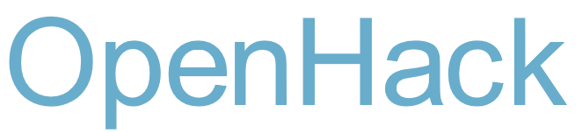
immersive | multi-day hack | code side-by-side with a Microsoft engineer | implement a given Azure scenario you saw today!
new york, november 7-9
register @ aka.ms/openhacknyc
Notes:
ARSDT – New York City Promo slide for OpenHack NYC:
Often, the best way to learn is to just write code. We’re hosting an immersive, multi-day hack to help you get started with Azure. OpenHack NYC on November 7-9 is challenge-based hack where you code side-by-side with a Microsoft engineer and implement a given scenario. Space is limited, so act fast and reserve your spot. Register @ aka.ms/openhacknyc

Slide 4
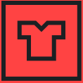
Azure Red Shirt Dev Tour ‘17
Whether you’re new to the cloud or a seasoned expert, you’ll learn something at the Azure Red Shirt Dev Tour ‘17. The Red Shirt Tour is all about code. Join Microsoft’s cloud chief, Scott Guthrie, as he codes live and demonstrates how Azure can help you solve some of your most vexing developer problems.
New York | October 20 | Register today @ aka.ms/newyorkrst

Slide 5
DevOps

Slide 6
Kickstart Your DevOps Journey
Introductory Meeting [1.5 hours]
Quick review of pipeline: Feedback.. Production -> Planning/Ideation. This review will help us answer the following:
Identify primary tools, processes and perceived weaknesses if any
Define needed participants/roles to be included in VSM (and hack) - includes name, email address, tittle, role (Homework?).
Schedule VSM (Aug 31-Sept 1) & Hack October ????
If time, identify any training desired
VSM – Day 1-2
Around the room intro’s
Short DevOps Training
Whiteboard Value Stream Map
Working Lunch
Plan hack priority - {if needed}
Define Success
Identify expected outcomes
Homework – if needed
Lock hack dates
Training (Docker, VSTS, Azure, Hybrid, whatever) if needed and time permits
Hackfest
Day 1 - Setup Teams; Identify requirements, Identify scribe; Perform Training; Hack rest of day 😊
Day 2- Hack all day ☺ 3pm Team scrums
Day 3-? Hack all day ☺
Last Day
Morning Test process; tweak as needed
Document – outline will be provided; Teams can use to share their success with their leadership
Working Lunch
Afternoon Document; Create follow-up plan (future hacks, deploy in production, work on different part of pipeline, etc)
2:30-3:30pm; 10-15 mins team presentations to all hackers and Q&A from other hack teams
Provide Feedback using Event Feedback URL
Plan Project Phase II
Define Post hack Schedule
Leadership team discussions of projects and priorities
Plan continued hack schedule
4:30pm hack ends

Slide 7






DevOps is the union of people, process, and tools to enable continuous delivery of value of our end uses.
DEV
OPS
1
People
2
Process
3
Tools
Shared Mission: Deliver a great product that inspires our customers to become raving fans
Notes:
People = Culture
Fundamental attributes of successful cultures:
Shared mission and incentives: infrastructure as code, apps as services, DevOps/all as teams
You need to consider your hardware as a commodity, (don't give your servers names) , servers are like farm animals, it is just harder if you let theids name them
Build deep instrumentation into services, push complexity up the stack
Rally around agile, shared metrics, CI, service owners on call, etc.
Changing the culture: any change takes time, changing culture is no exception and you can't do it alone, exploit compelling events to change culture: downtimes, cloud adoption, devops buzz
PROCESS Definition and design, compliance, and continuous improvement
PEOPLE Responsibilities, management, skills development, and discipline
Tools and infrastructure

Slide 8
Who Should/Must Attend/Participate
* Management / Sr. Management Sponsor
Architects
Business Analyst
DevOps Teams
Innovation Teams
Developers
Infrastructure
Networking
Security
DBA
QA
Release Management
Management
DevOps is for senior architects, developers and engineers as well as the Innovation and DevOps teams & leadership.
- Everyone enjoys the benefits
OR Else??

Slide 9
Role of Security in DevOps aka DevSecOps
Incorporate security necessities into every aspect of the business; enable others to automate compliance
Making the business case:
GOVERNANCE
Security
Culture, politics, processes & laws that determine how a company should conduct itself.
Confidentiality
TRUST
Availability
Effect if uncertainty on organizational objectives.
Act of adhering & demonstrating adherence to laws, regulations, corporate policies & procedures.
Integrity
Privacy
COMPLIANCE
RISK
Help build a product that will inspire our customers to become raving fans

Slide 10
Roles and Responsibilities
Security - Incorporate security necessities into every aspect of the business; enable others to automate compliance
Development – Quickly build, deploy & update a product that our customers love; Enable other groups by building what they need to support you.
IS/IT – Build infrastructure as code; enable others by helping to eliminate waste throughout the technology landscape
Management – Enable the teams by giving them flexibility, guidance and support to do what is needed; remove obstacles
Senior Management – Embrace Cultural Change; Drive Transformation in the organization.
Everyone – Help build a product that will inspire our customers to become raving fans
Notes:
Security - Help find a way to incorporate security necessities into every aspect of the business; without getting in the way unnecessarily

Slide 11
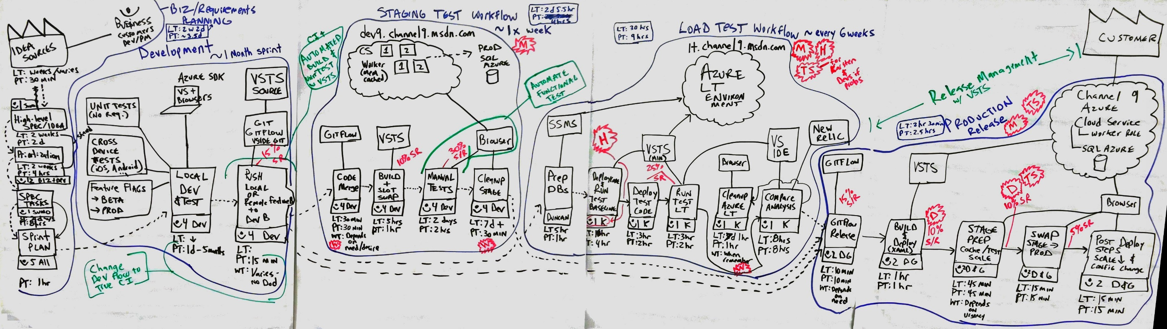
Value Stream Mapping
Analyze and Share “Waste”
Help to shorten the lead time
Value Stream Map の例

Slide 12
Expected results
Decrease Application and Application hotfix/patch deployment time by many months
Teach your experts how they can use the latest technology to improve their results
Significantly reduce waste cycles in many aspects of the organization as it relates to technology and deployment
Work cross teams collaboratively
Get Hands-on solving the teams most challenging problems with Microsoft Sr Experts working side-by-side with them.
Increase DevOps journey speed and performance
Much more

Slide 13
Introduction to the VSM
DevOps, Value Stream Mapping and Hack
Objective: Reduce waste and inefficiency in the development lifecycle; improve performance and time to market
Expected results: Decrease App and patch deployment time by many months.
The DevOps program is designed for senior architects, developers and engineers as well as the Innovation and DevOps teams. This program and event series requires full management support. Department heads from many teams are required participants, so the program needs leadership buy-in. The benefits are astonishing. In a matter of a few days of prep work, a couple days of a Value Stream Analysis and a couple days of a hackathon, the team collectively learns how to be ultra-efficient. We have seen this take a large organizations time to market for new features from a year to days and hotfixes from months to hours. There are incredible tools and processes available to turn any organization into one that operates, with security in mind, at startup speed.
These processes are gaining much momentum in the technology space as organizations learn how to tweak three things to make massive impact and results a realization. These three components are People, Processes and Tools. The most important of these are the people and their knowledge and understanding of what is possible with the right processes and tools. We wrap-up the DevOps course with a multi-day hackathon where we tackle one or more of your challenges with your team working with us. This solution is usually ready for production and is often expanded to include multiple projects as the teams often split up into multiple groups to work on different parts of the problem. The teams often find they have additional time to keep going to solve even more problems during the hack. The hack creates an addictive behavior. They realize how fast they can work once the waste is identified and cut, they want to work this way all the time.
Customer Quotes:
Aha Moment: SQL Database: It just worked, even when we created a clone of the app in a completely different region! We were not expecting this! The DNS made it all work
“It’s a fundamental shift from where we are today to what the future can / will look like and if anything, it was eye-opening and that we need to start changing our approach / thinking as the world is changing around us and we need to adapt”
“Value Stream Mapping was enlightening; having the team work together was key”
“The exercise to map existing development and deployment processes really starts to bring to light the areas in which massive productivity gains can be made”
“I passed the 70-533 Implementing Azure Infrastructure Solutions exam today with an 855. Some tough questions but I spent a lot of time studying using MeasureUp along with attending the 4-day [DevOps] workshop made the difference”

Slide 14
Hackathon / Hackfest
A hackathon is usually an all-day or multi-day event where developers and sometimes others, architects, security professionals, engineers, etc., come together as a team to build/develop a solution to a problem. A hackathon, will generally have multiple teams all solving a different problem. Gamification can be added to a hackathon to make it even more fun. The hackathon is used as a catalyst to help teams hyper-focus on a single problem, bringing this problem to resolution in a short period of time. It is also a teaches how to use an internal hackathon as catalyst for any team to solve serious problems. It makes a great team building exercise and many companies once fully introduced to hackathons will do hacks as part of their giving or charitable work. Microsoft will supply staff to help with the first hackathon and can be leveraged in future hacks if needed.
Customer Quotes:
“The participation of resources from different areas really helps share what the other side does and the pains they feel”
“Touching technology as part of the learning processes really accelerates the consumption of new information”
“Low risk accelerator to provide business value, we have to move this forward”
“Demonstrated benefits typical of a PaaS solution - reduced complexity, simplified deployments, reduced time to market”
“New architectures and approaches required to take best advantage of the Azure Cloud capabilities and approach”

Slide 15
DevOps Practices
Primary
Secondary
Infrastructure as Code (IaC)
Continuous Integration
Automated Testing
Continuous Deployment
Release Management
App Performance Monitoring
Load Testing & Auto-Scale
Availability Monitoring
Change/Configuration Management
Feature Flags
Automated Environment De-Provisioning
Self Service Environments
Automated Recovery (Rollback & Roll-Forward)
Hypothesis Driven Development
Testing in Production
Fault Injection
Usage Monitoring/User Telemetry
http://www.itproguy.com/devops-practices/

Slide 16
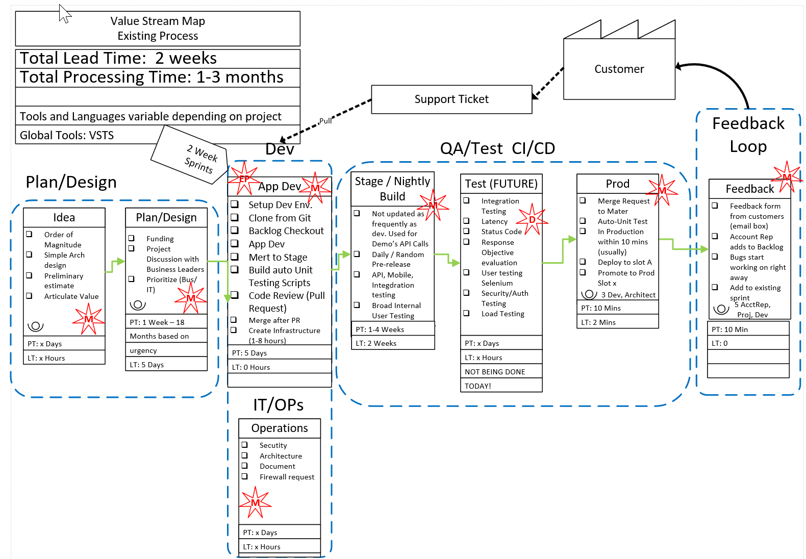
Before DevOps
2 Week Lead time
1-3 Months Processing
Waste in every step

Slide 17
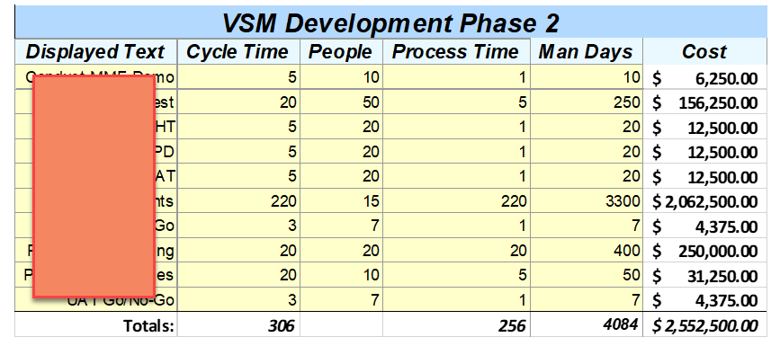
Workflow Tracking
How long does it take?
Where is the waste?
How much quantifiable waste?
Total time?
Homerun: Total Cost

Slide 18
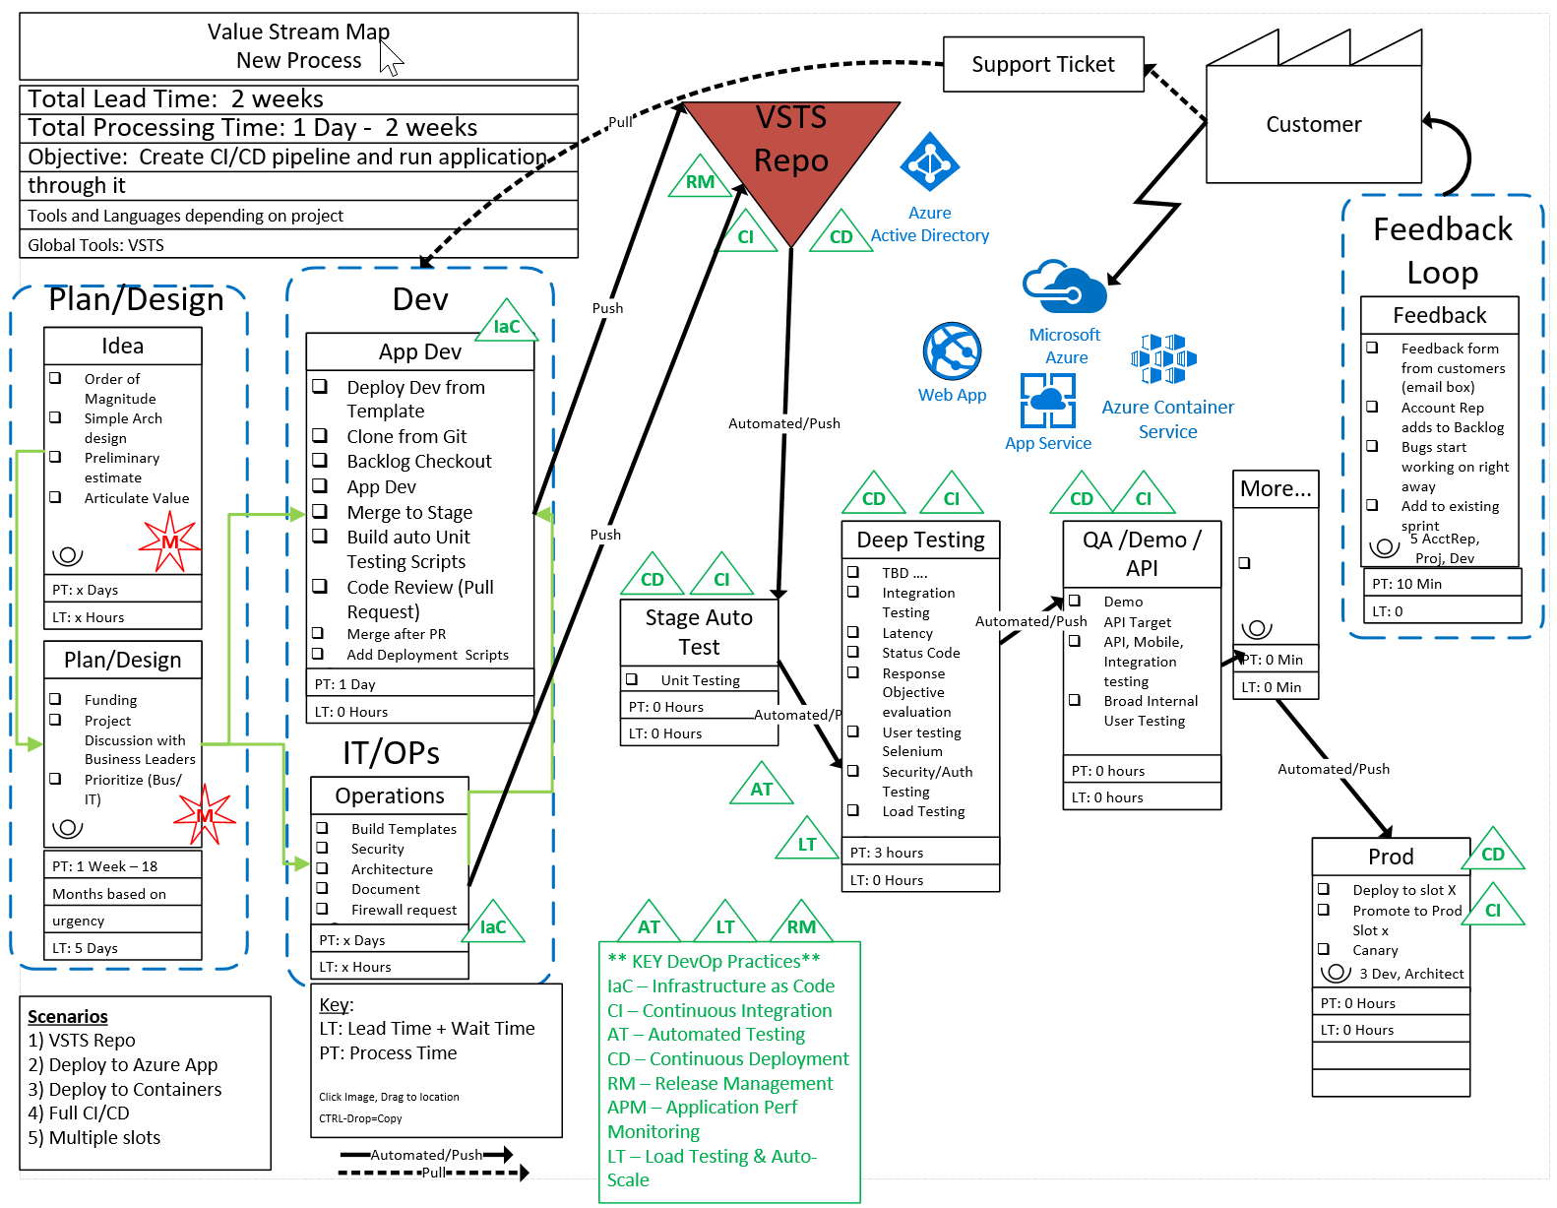
After DevOps
2 Week Lead time
1 Day – 2 Weeks processing time
Not all waste was cut in first pass
Fully automated and streamlined process with an application flowing through the system.
Investment: 3 weeks

Slide 19
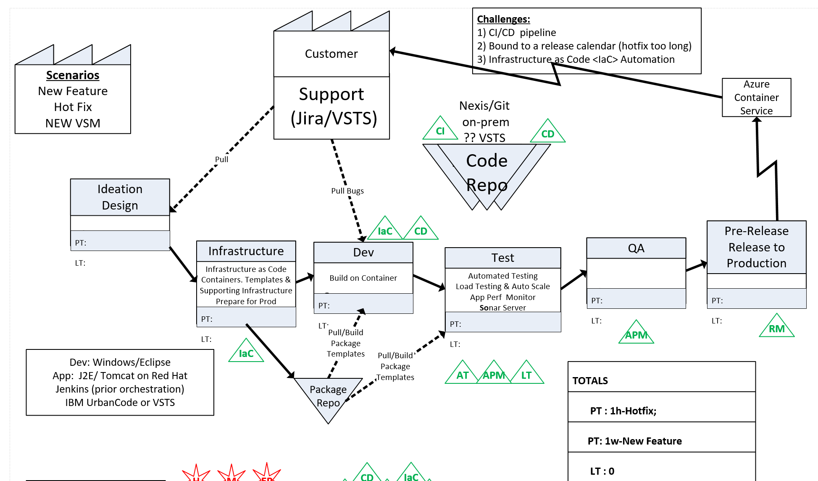
Release Cycle: 18 months → 4 weeks Hotfix: 6 week → Same Day Investment: 3 weeks

Slide 20
Making it real
Whiteboarding Demo

Slide 21
Security
Azure-The Most Secure and Trusted Cloud

Slide 22
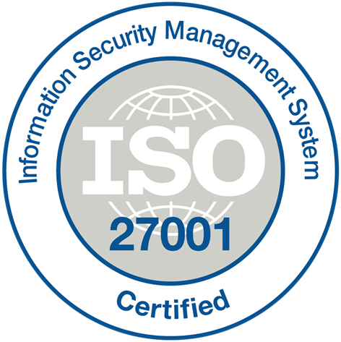

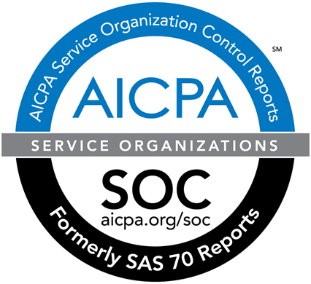
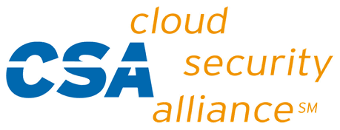
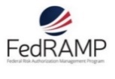

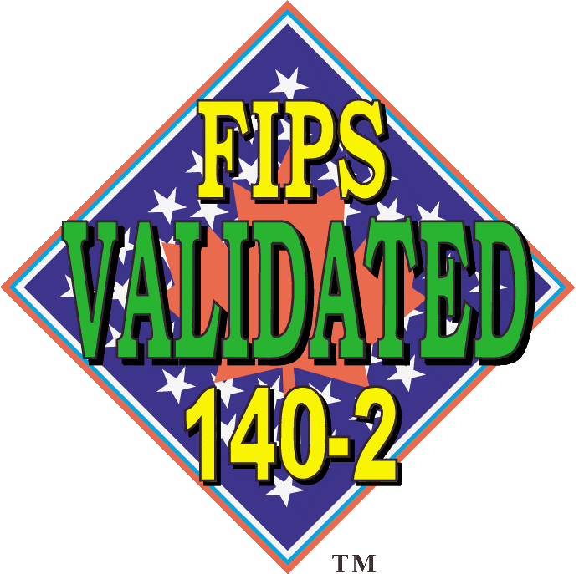






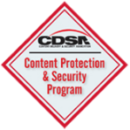



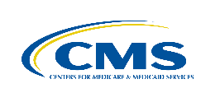










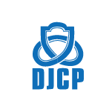

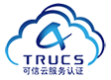


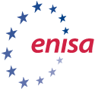










THE TRUSTED CLOUD
July 2017
Azure has the deepest and most comprehensive compliance coverage in the industry
GLOBAL
ISO 27017
ISO 22301
ISO 9001
SOC 1
Type 2
SOC 2
Type 2
SOC 3
CSA STAR
Self-Assessment
CSA STAR
Certification
CSA STAR
Attestation
ISO 27001
ISO 27018
US GOV
Moderate
JAB P-ATO
High
JAB P-ATO
DoD DISA
SRG Level 2
DoD DISA
SRG Level 4
DoD DISA
SRG Level 5
SP 800-171
FIPS 140-2
Section 508 VPAT
ITAR
CJIS
IRS 1075
INDUSTRY
PCI DSS
Level 1
CDSA
MPAA
FACT UK
Shared
Assessments
FISC Japan
HIPAA / HITECH Act
HITRUST
GxP
21 CFR Part 11
MARS-E
IG Toolkit UK
FERPA
GLBA
FFIEC
REGIONAL
Argentina PDPA
EU
Model Clauses
UK
G-Cloud
China
DJCP
China
GB 18030
China
TRUCS
Singapore
MTCS
Australia
IRAP/CCSL
New Zealand
GCIO
Japan My
Number Act
ENISA
IAF
Japan CS Mark Gold
Spain
ENS
Spain
DPA
India
MeitY
Canada
Privacy Laws
Privacy
Shield
Germany IT
Grundschutz
workbook
Notes:
Feb-2017: Azure compliance coverage includes 54 offerings.

Slide 23
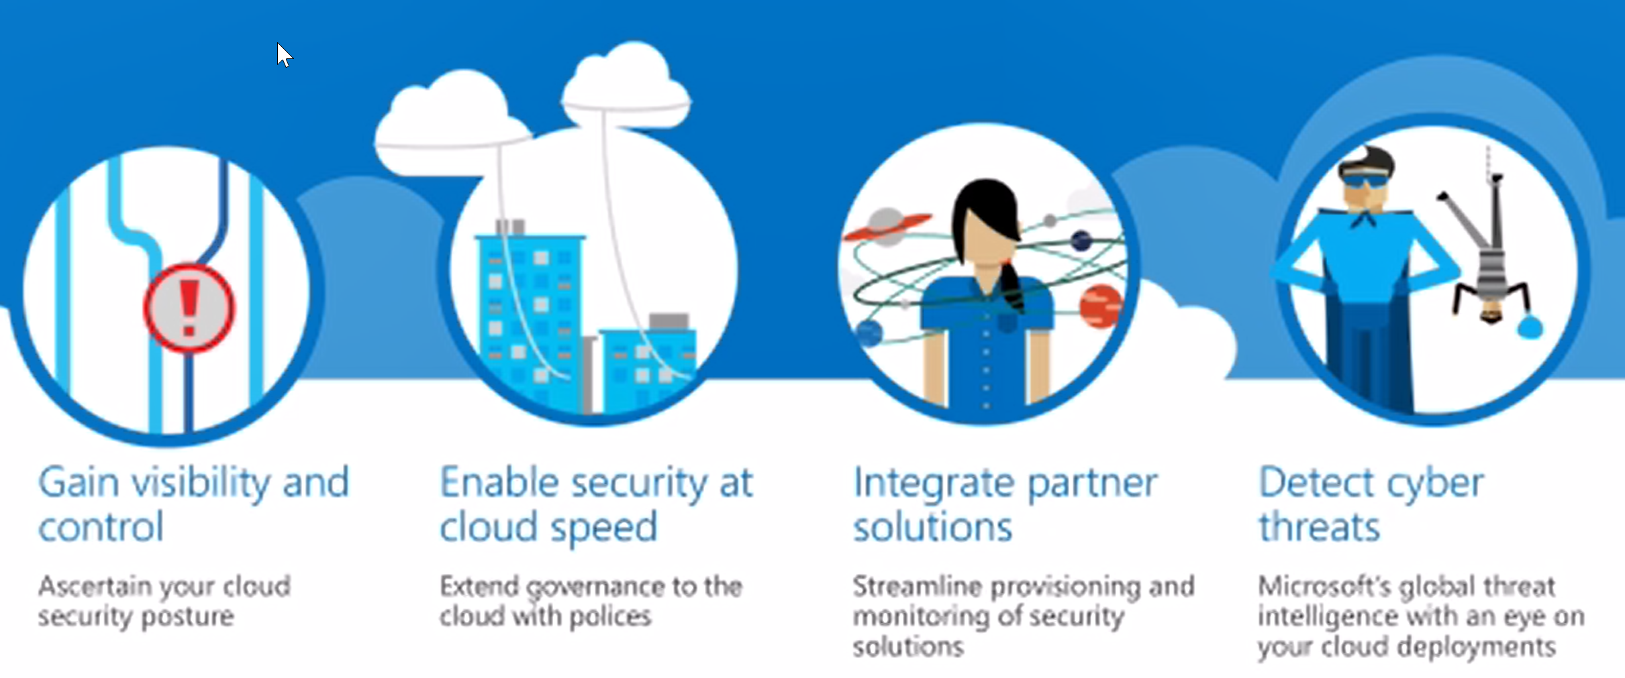
Azure Security Center
https://docs.microsoft.com/en-us/azure/security-center/security-center-intro
Notes:
https://docs.microsoft.com/en-us/azure/security-center/security-center-intro
Why use Security Center?
Unified visibility and control+
Understand security state across hybrid workloads. Manage security across all your hybrid cloud workloads – on-premises, Azure, and other cloud platforms – in one console. Built-in dashboards provide instant insights into security issues that require attention.
Visibility into cloud workloads. Keep pace with rapidly changing cloud workloads. Automatically discover and onboard new resources created in your Azure subscriptions.
Centralized policy management. Ensure compliance with company or regulatory security requirements by centrally managing security policies across all your hybrid cloud workloads.
Security data from many sources. Collect, search, and analyze security data from a variety of sources, including connected partner solutions like network firewalls and other Microsoft services.
Integration with existing security workflows. Access, integrate, and analyze security information using REST APIs to connect existing tools and processes.
Compliance reporting. Use security data and insights to demonstrate compliance and easily generate evidence for auditors.
+
Adaptive threat prevention+
Continuous security assessment. Monitor the security of machines, networks, and Azure services using hundreds of built-in security assessments or create your own. Identify software and configurations that are vulnerable to attack.
Actionable recommendations. Remediate security vulnerabilities before they can be exploited by attackers with prioritized, actionable security recommendations and built-in automation playbooks.
Adaptive application controls. Block malware and other unwanted applications by applying whitelisting recommendations adapted to your specific Azure workloads and powered by machine learning.
Network access security. Reduce the network attack surface with just-in-time, controlled access to management ports on Azure VMs, drastically reducing exposure to brute force and other network attacks.
+
Intelligent threat detection and response+
Industry’s most extensive threat intelligence. Tap into the Microsoft Intelligent Security Graph, which uses trillions of signals from Microsoft services and systems around the globe to identify new and evolving threats.
Advanced threat detection. Use built-in behavioral analytics and machine learning to identify attacks and zero-day exploits. Monitor networks, machines, and cloud services for incoming attacks and post-breach activity.
Prioritized alerts and Incidents. Focus on the most critical threats first with prioritized security alerts and incidents that map alerts of different types into a single attack campaign. Create your own custom security alerts as well.
Streamlined investigation. Quickly assess the scope and impact of an attack with a visual, interactive experience. Use predefined or ad hoc queries for deeper exploration of security data.
Contextual threat intelligence. Visualize the source of attacks on an interactive world map. Use built-in threat intelligence reports to gain valuable insight into the techniques and objectives of known malicious actors.

Slide 24
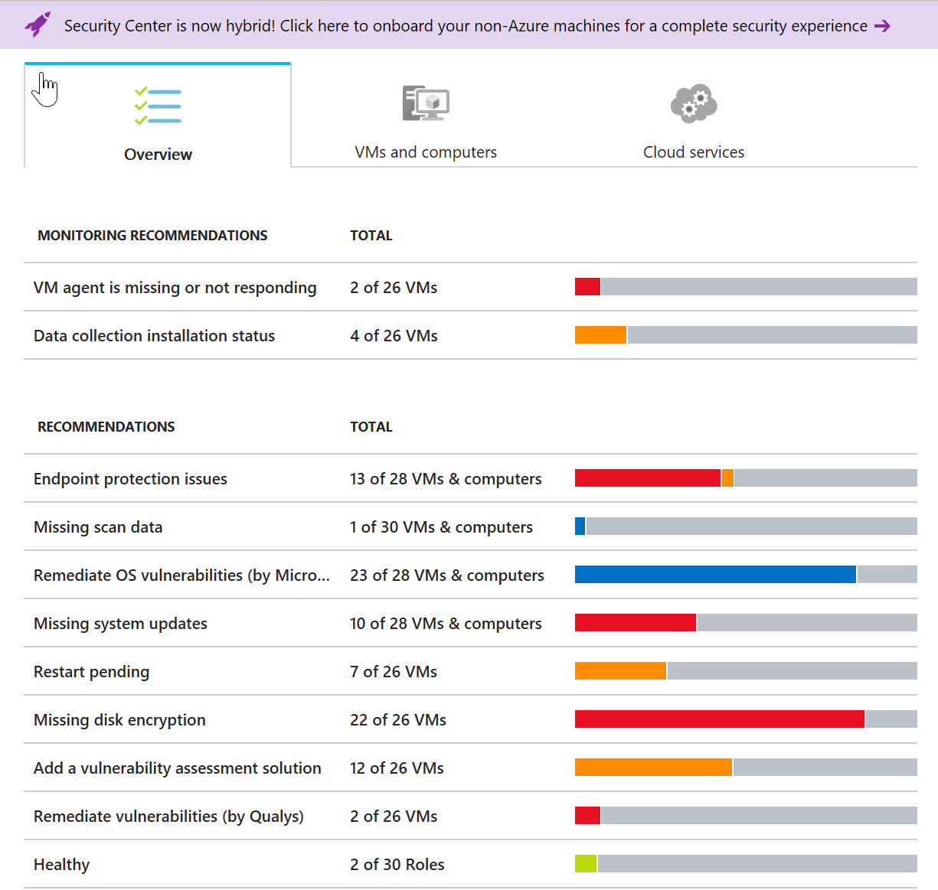
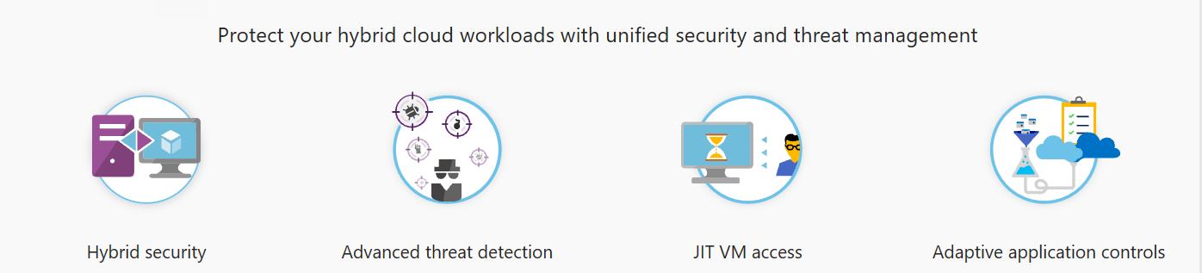
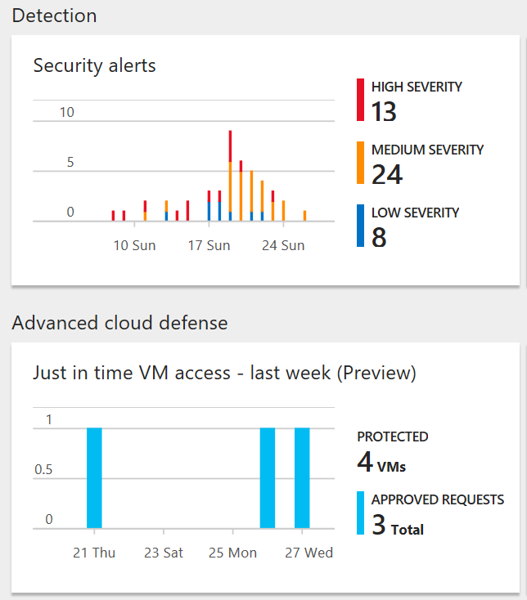
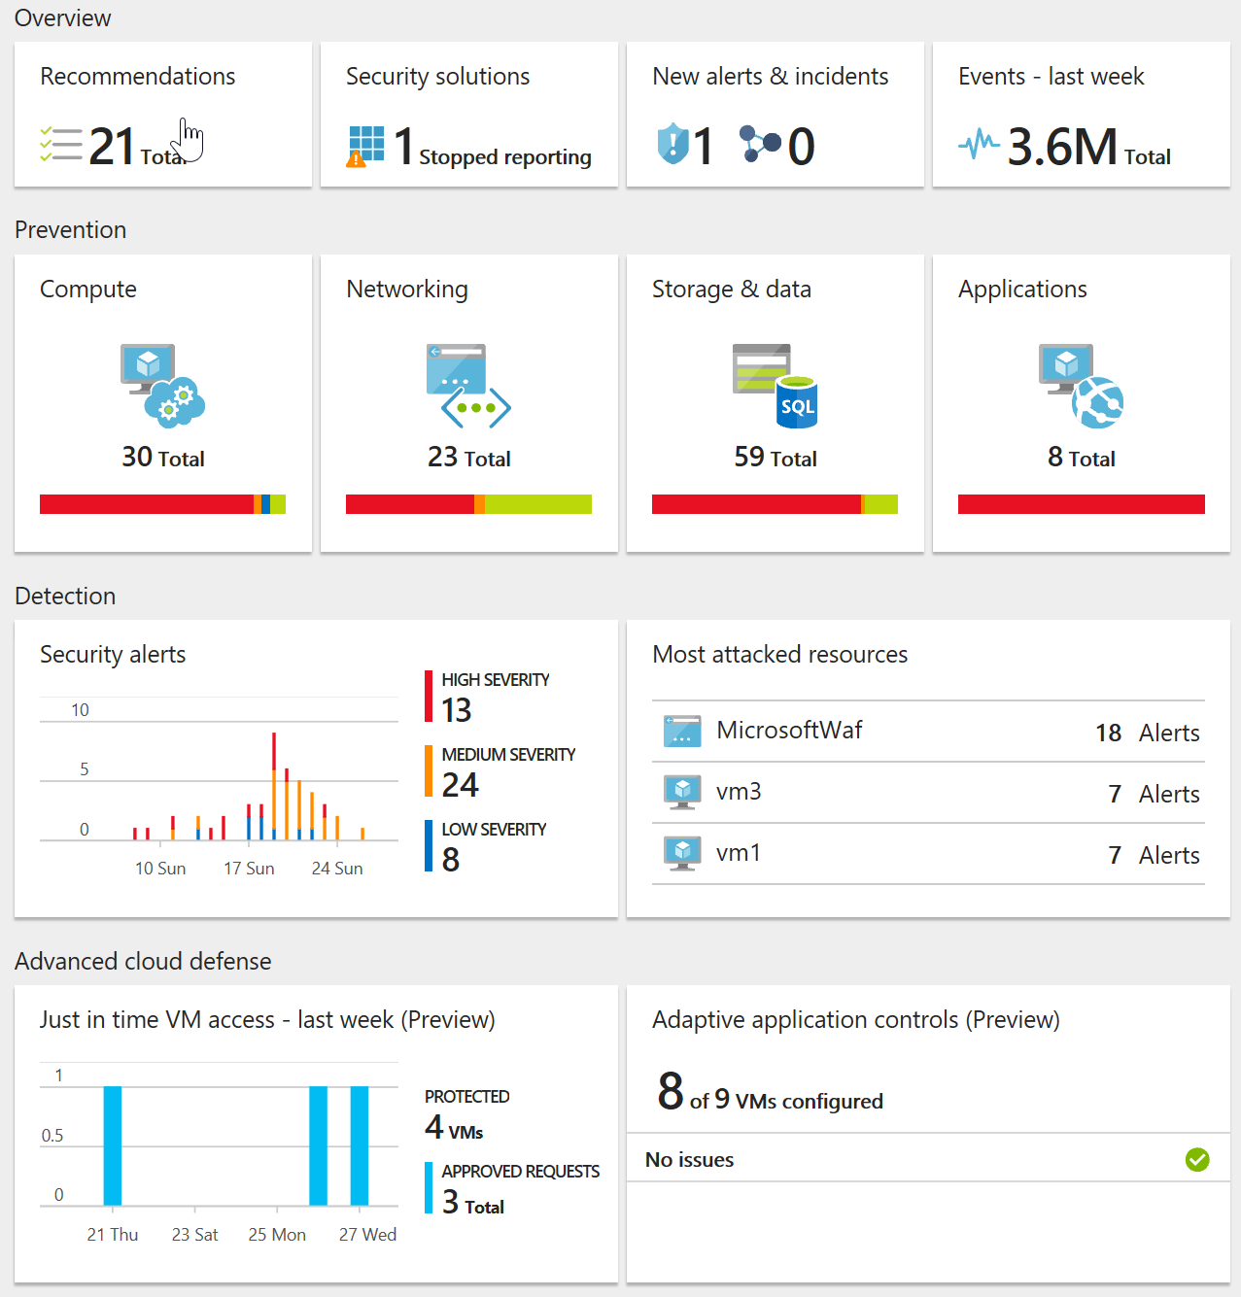
Let’s Take a Look
Security Center is Hybrid!!!

